Slide 1
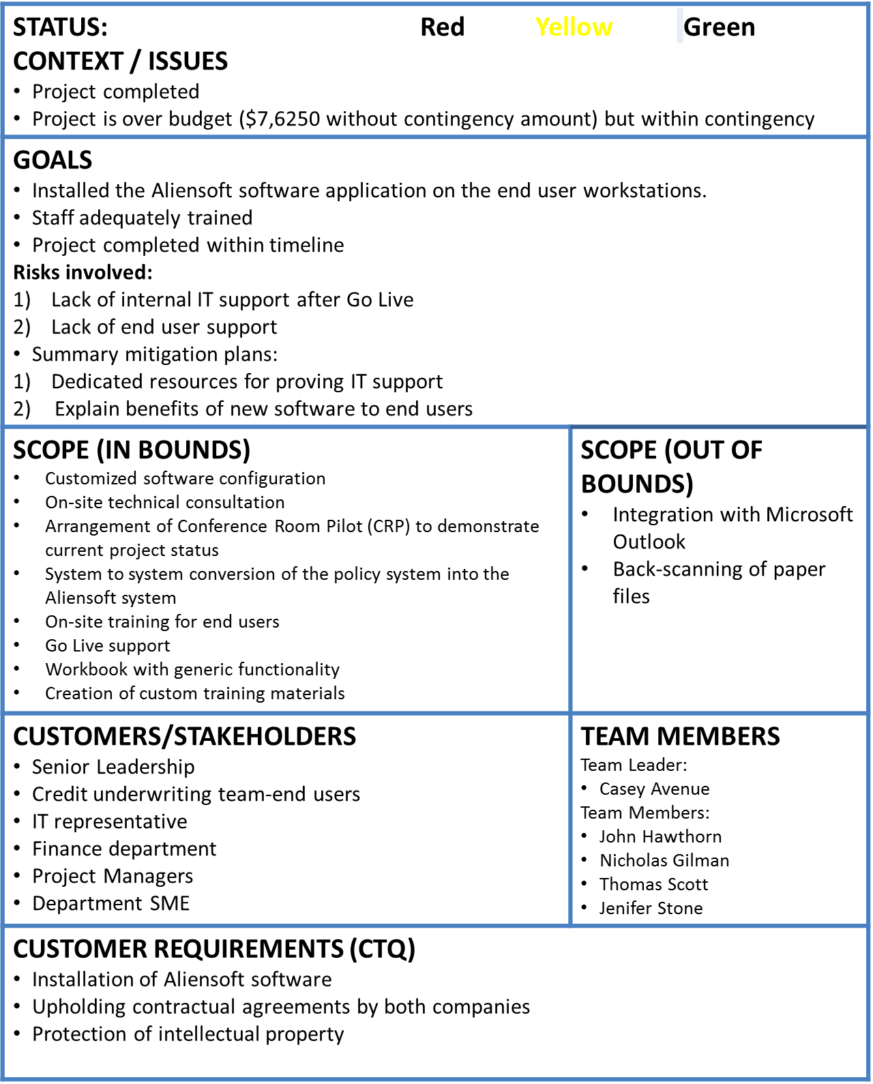
Aliensoft Implementation at AIP
Jun-11-2017
Tom DiCaprio
VISION OF SUCCESS Improved efficiency of underwriting department Consolidated repository of policy documents
PROJECT SCHEDULE
RESOURCES (other than team members) Time commitment for the project: 11 weeks External Resources: Aliensoft software license, legal paperwork Internal Resources: Office space, Conference rooms Equipment: Computer systems, basic necessary softwares Materials: Printers, VoIP, Stationery
Project Schedule | Owner | Planned Date | Actual Date | % Complete
1. Kickoff Meeting A | Casey Avenue | March 27 | March 27 | 100%
2. Initial Configuration B | Nicholas Gilman | April 3 | April 3 | 100%
3. Initial Configuration C | Nicholas Gilman | April 10 | April 10 | 100%
4. Technical Installs D | John Hawthorn | April 17 | April 17 | 100%
5. Initial Configuration E | Nicholas Gilman | April 24 | April 24 | 100%
6. Test Conversion F | John Hawthorn | May 1 | May 1 | 10%
7. Conference Room Pilot Prep G | John Hawthorn | May 8 | May 8 | 100%
8. Conference Room Pilot Prep (CRP) H | John Hawthorn | May 15 | May 15 | 100%
9. Updated configuration, prep for Training week I | John Hawthorn | May 22 | May 22 | 100%
10. Training Week J | Nicholas Gilman | May 29 | May 29 | 100%
Weekend 10 to 11 Production Conversion K | John Hawthorn | June 3 | June 3 | 100%
11. Go Live week L | Casey Avenue | June 5 | June 5 | 100%
Aliensoft Team
Project Lead
Consultants
Senior Leadership
IT team
Trainer

Slide 2
FINAL BUDGET
 |  | Week | Cumulative Budget - No Contingency | Cumulative Budget - With Contingency | Actual Cumulative Expenses | Cost Variance (EV-AC) - No Contingency
1 | Kickoff Meeting | 1 | $ 8,600 | $ 9,708 | $ 14,700 | $ (6,100)
2 | Initial Configuration | 2 | $ 15,400 | $ 17,617 | $ 19,900 | $ (4,500)
3 | Initial Configuration | 3 | $ 22,200 | $ 25,525 | $ 27,900 | $ (5,700)
4 | Technical Installs | 4 | $ 35,700 | $ 40,133 | $ 47,300 | $ (11,600)
5 | Initial Configuration | 5 | $ 42,600 | $ 48,142 | $ 50,300 | $ (7,700)
6 | Test Conversion | 6 | $ 50,100 | $ 56,750 | $ 55,500 | $ (5,400)
7 | Conference Room Pilot Prep | 7 | $ 56,075 | $ 63,833 | $ 61,900 | $ (5,825)
8 | Conference Room Pilot (CRP) | 8 | $ 65,575 | $ 74,442 | $ 81,900 | $ (16,325)
9 | Updated configuration, prep for Training week | 9 | $ 71,575 | $ 81,550 | $ 87,400 | $ (15,825)
10 | Training Week | 10 | $ 88,025 | $ 99,108 | $ 98,500 | $ (10,475)
 | Production Conversion | 0 | $ 102,025 | $ 114,217 | $ 108,700 | $ (6,675)
11 | Go Live week | 11 | $ 113,625 | $ 126,925 | $ 121,250 | $ (7,625)

Slide 3
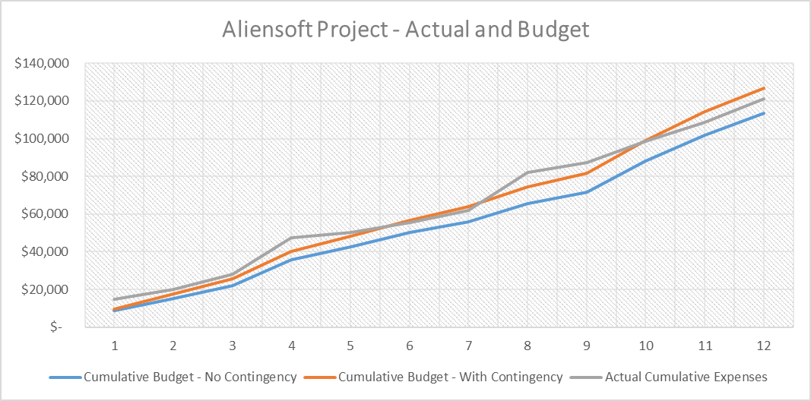
ACTUAL v. PLANNED BUDGET

Slide 4
INTIAL RISK ASSESSMENT
Description of the risk | Type of risk | Probability & Consequences | Risk Mitigation Strategy
Time overruns | Execution | 7% and $100000 = $7,000 | Careful planning and flexibility with recourses
Staff pulled away | Execution | 10% and $20000 = $2000 | Find backup recourses
Ineffective training | Contractual | 8% and $50,000 = $4000 | Find other company working with Aliensoft software as backup.
Installation fails | Contractual/Execution | 15% and $90,000 = $13500 | Accept.
Aliensoft financial/ staff problems | Contractual/ Legal | 5% and $200,000 = $10000 | Buy insurance for counteragents relationships.
Financial distress | Financial | 0.5% and 300,000 = $15,000 | Accept
 | 6 (Six) | $51,500

Slide 5
ISSUES ENCOUNTERED DURING THE COMBINED WEEK (4-5)
Event 2 - IT
  The Aliensoft Technical Consultant (Theo Foster) came onsite to install the software on the workstations and also train our Athens Insurance Partner’s Subject Matter Expert (SME) on the Administration of the system including security and maintenance. Theo noticed that the security setup for the domain controller was inappropriate for the Aliensoft implementation.
  John Hawthorn totally rebuild the security setup for all the programs on all the computer programs. This took John another 20 hours of project time that was not budgeted.
Event 3 – Underwriting
  The Athens Insurance Partners SME needed to comment on the configuration and design of the software so that it would fit our business needs for new insurance policies.
  Nicholas Gilman worked diligently with Alexa on the description of each of the processes in the Athens Insurance Partners environment, and Alexa has enough information to configure the system.
Event 6 – Finance
  Athens Insurance Partners received a letter from Aliensoft announcing that the Professional Services Fees would be increased by 10% as of week #6.
  Tom Scott contacted Aliensoft and was able to convince them that changing a signed contract was not a good idea. Aliensoft agreed and sent another letter that stated that the cost increase was only for future work after finishing up the current project.

Slide 6
ISSUES ENCOUNTERED DURING THE COMBINED WEEKS (6-11)
Event 4 - Underwriting
  The Aliensoft Management Consultant (Alexa White) came to the office for three (3 days) to conduct the CRP – Conference Room Pilot and demonstrate the system the way that it would look like once the company went live. During these 3 days, a large restaurant deal in the Athens area appeared, and there was a lot of competitive pressure to create a sales proposal and seal the deal as quickly as possible in order to create revenue for Athens Insurance Partners.
  Nick Gilman was pulled out of the CRP to work on the restaurant proposal. This resulted in a 1 week delay of the CRP, as Alexa did not have anyone to show the software to. She came back the following week and charged an additional charged 36 hours and $1,500 in travel costs (because of the late booking of the flight).
Event 6 – Finance
  Tom DiCaprio, the CEO of Athens Insurance Partners asked his Finance department to scrutinize all the invoices from Aliensoft, as well as other vendors and compare them against the signed contracts.
  Tom Scott did not find any discrepancies in the invoices.
Event 4 – Underwriting
  The Aliensoft Management Consultant (Alexa White) sent you an urgent email that the custom training documentation was not ready before the end users started their training. Therefore, she would have to train on the generic documentation that used the sample company “Ace Insurance” rather than the policies and procedures of Athens Insurance Partners itself.
  Nick Gilman talked with his colleagues and over the weekend with a lot of pizza and drinks they wrote the entire manual. The cost was $1,000 in overtime, but there were no delays to the project.
Event 6 – Finance
  The Training and Go Live events went smoothly, the end users were happy and Tom DiCaprio emailed Casey Avenue to take the project team from Aliensoft as well as the team members from Athens Insurance Partners to lunch at the Little Italy Pizza restaurant. The cost of $300 was charged to the project.

Slide 7
RISK MITIGATION PLAN
Seek additional funding
  Explain to Tom Dicaprio about the events that led to the project going over-budget and seek additional contingency amount.
Increase offsite consulting by Aliensoft in future
  Persuade Aliensoft consultants to work offsite as much as possible for future weeks.
  This would reduce travel expenses.
Improve co-ordination between Aliensoft and AIP teams
  Motivate teams to maintain high level of communications between them.
  This would reduce any potential surprises(eg. Changes to Professional Services Fees ) in future.
Regular forecasting of resource usage
  Constantly review the number of people currently working on a project and the project's future resource needs on a weekly basis.
Scope management
  Carefully manage scope so that additional work can be captured.
  Seek additional funding to cover the cost of extra work thus maintaining the project under budget.
Maintain functional resources’ work-hour allocation
  Constantly be in touch with departmental managers so that the 3 resources are maintaining their work schedule for this project.

Slide 8
FINAL ANALYSIS
Project performance
  Project achieved the technical goals that it set out to accomplish.
Administrative performance
  All organizational policies were adhered to with respect to administrative practices.
Organizational structure
  Organizational structure of pulling and utilizing functional resources helped the project tremendously.
Team performance
  Worked on weekends whenever required
  Finished the project within timeline
Benefits to the organization
  Improved efficiency of underwriting department
  Consolidated repository of policy documents

Slide 9
LESSONS LEARNED
Always keep close eye on project budget
  Carefully monitoring project budget helps manage unexpected costs efficiently.
Maintain high level of co-ordination between external client team and your team
  Motivate teams to maintain high level of communications between them.
  This would reduce any potential surprises
Explicitly define ownership responsibility of each task
  This prevents conflicts within the team regarding ownership of tasks
Clearly define scope in beginning of project
  This prevents any future surprises.
  Carefully manage scope so that additional work can be captured.
  Seek additional funding to cover the cost of extra work thus maintaining the project under budget.
Maintain functional resources’ work-hour allocation
  Constantly be in touch with departmental managers so that the 3 resources are maintaining their work schedule for this project.
Keep project sponsor in the loop throughout the course of project
  Strong advocacy by sponsor avoids project being terminated midway.
  Helps seek additional funding if budget goes over contingency amount.
Careful recourse selection and planning is important
  Poor planning and uncareful recourse selection can lead to an unpredicted increase in costs and even early project termination.

